Slide 1
PROJECT REVIEW – 2
TITLE OF PROJECT:
PLAYHIVE
PRESENTED BY:
SARAVANAKUMAR M 221CA147, III BCA B Dr. N.G.P. Arts and Science College
UNDER THE GUIDANCE:
Ms. K. GOMATHY
Professor, Dept. of Computer Applications
Dr. N.G.P. Arts And Science College

Slide 2
INTRODUCTION
Play Hive is a next-generation video-sharing platform built with the MERN stack, offering an immersive and interactive experience beyond traditional platforms. It empowers users to create their own channels, upload videos, and engage with content through likes, subscriptions, and saved playlists. Unlike conventional video platforms, Play Hive introduces unique features like the Watch Together mode, allowing users to sync videos with friends in real time, enhancing the social aspect of content consumption.
In addition to seamless video streaming, Play Hive enhances entertainment with built-in mini-games, enabling users to take engaging breaks between watching sessions. The advanced video player offers smarter controls, including gesture-based navigation for improved usability. To personalize the experience, the home screen dynamically adapts based on user preferences and displays time-based greetings, making each visit feel unique. With innovation at its core, Play Hive is redefining the way users interact with online video content.

Slide 3
FEATURES OVERVIEW
Google Login
– Sign in easily & securely
Channel Creation
– Customize your profile & upload videos
Smart Video Player
– Tap left to rewind, right to speed up
Watch Together
– Enjoy real-time synced viewing
Mini-Games
– Play fun games like Tic-Tac-Toe
Personalized Home
– Get a greeting based on the time of day

Slide 4
Existing System
Platforms like YouTube provide basic video functionalities but lack interactive collaboration features.
No real-time shared watching experience.
Standardized video players lack enhanced user controls.

Slide 5
Proposed System
PLAY HIVE introduces:
Google-based authentication for secure login
Personalized channels for creators
Advanced video player with smart controls
Watch Together feature for group streaming
Mini-games like Tic-Tac-Toe to boost engagement
Custom homepage with dynamic greetings

Slide 6
SOFTWARE REQUIREMENTS
Front End : ReactJS for Responsive and dynamic UI design
Back End : Node.js and Express.js for server logic
Database : MongoDB
Authentication : Oauth (Google Identity Platform)

Slide 7
MODULE DESCRIPTION
Authentication Module
– Users log in using Google OAuth for secure access.
User & Channel Management
– Users can create a channel, upload videos, and customize profiles.
Video Streaming & Engagement
– Watch, like, subscribe, and save videos with real-time view tracking.
Watch Together Feature
– Sync videos with friends for a shared viewing experience.

Slide 8
MODULE DESCRIPTION
Advanced Video Player
– Custom controls allow better navigation
Mini-Games Module
– Built-in games like Tic-Tac-Toe for added entertainment.

Slide 9
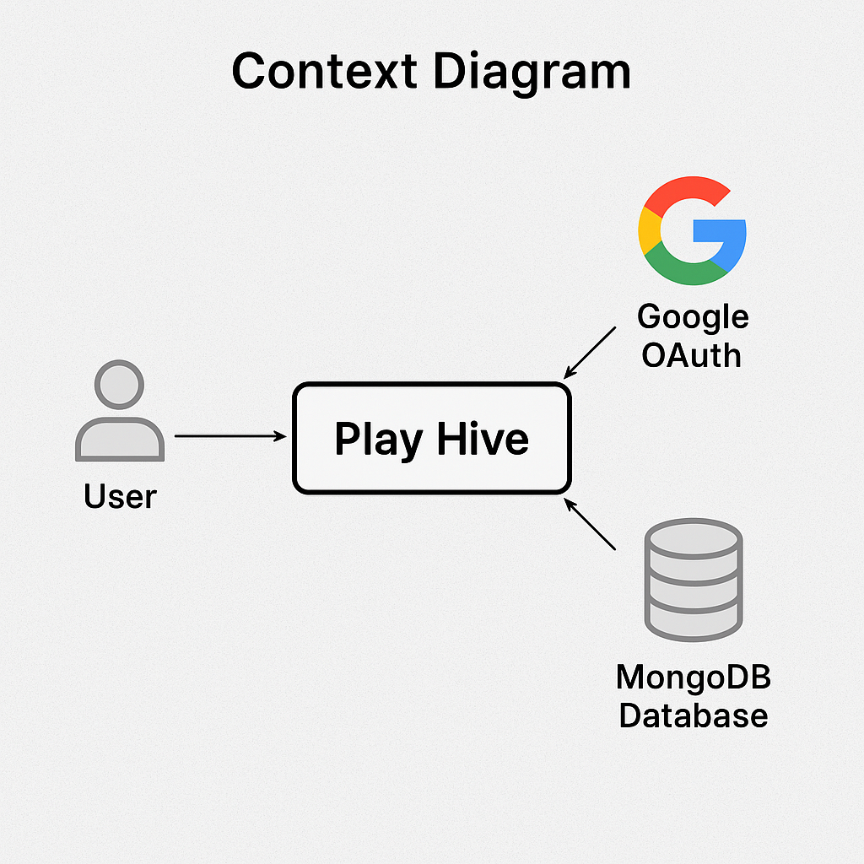
DATA FLOW DIAGRAM
LEVEL 0:

Slide 10
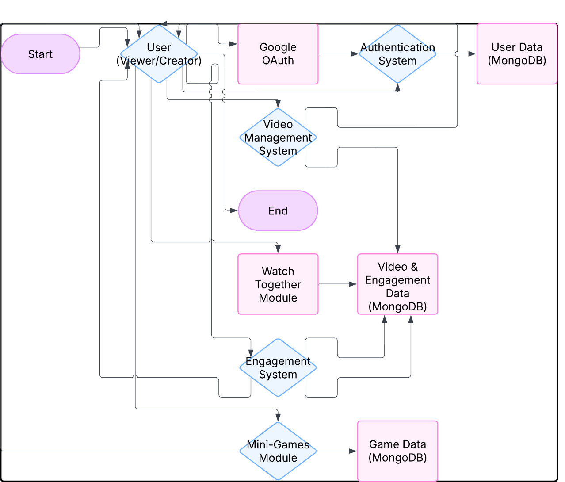
DATA FLOW DIAGRAM
LEVEL 1:

Slide 11
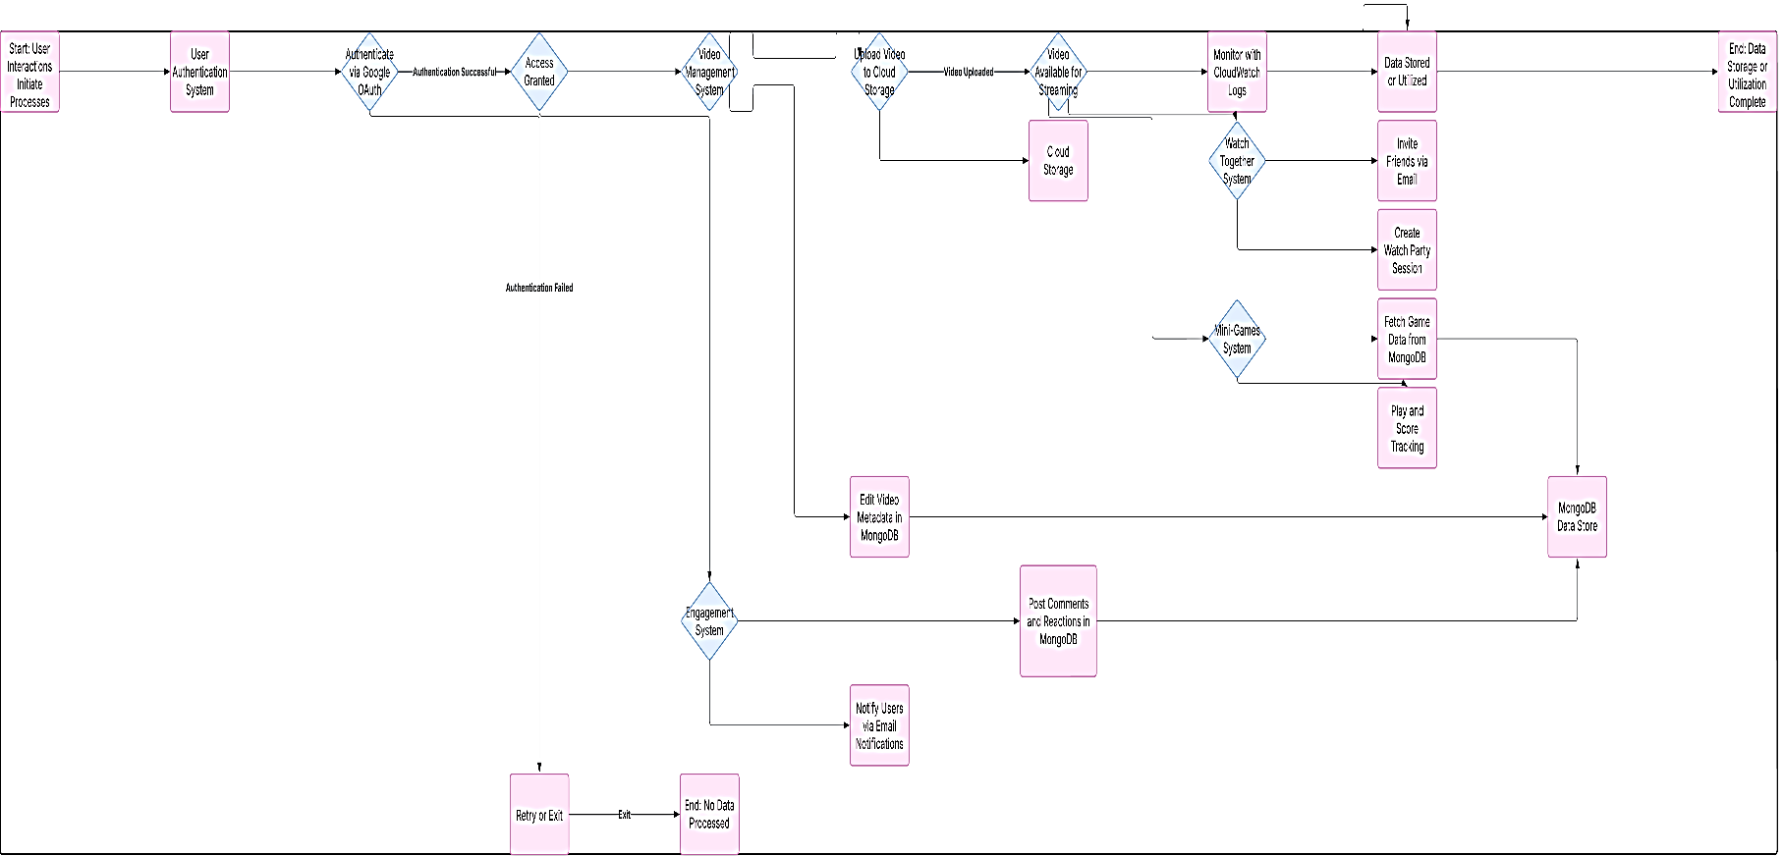
DATA FLOW DIAGRAM
LEVEL 2:

Slide 12
FUTURE ENHANCEMENT
AI-Powered Video Recommendations – Smart suggestions on the homepage based on user interests and watch history.
Dynamic Backgrounds – Adjusts based on time (bright in the morning, dark mode at night).
Live Video Streaming with Screen Sharing – Users can go live and share their screens for interactive sessions.
Interactive Comment System – Users can reply with GIFs, voice notes, and reactions for more engagement.

Slide 13
CONCLUSION
PLAY HIVE offers a modern and interactive video-sharing experience with advanced playback controls, a Watch Together feature, fun mini-games, and a dynamic, user-personalized home page. With features like subscriptions, likes, and a customized video player, it enhances user engagement and content discovery. As the platform continues to evolve, future updates will focus on integrating live streaming, screen sharing, and more interactive community-driven experiences.

Slide 14



